Slide 1

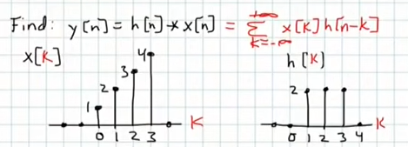
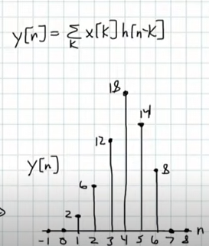
Convolution - advanced signal processing
It is used to compute output of LTI system, given input x[n] and impulse h[n]

Slide 2
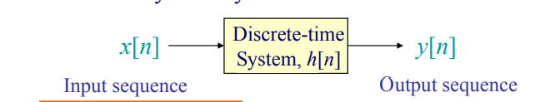
Convolution is a mathematical operation on two functions (f and g) that produces a third function expressing how the shape of one is modified by the other.
Convolution is one of the most useful operators that finds its application in science, engineering, and mathematics
The Discrete-Time Convolution (DTC) is one of the most important operations in a discrete-time signal analysis. The operation relates the output sequence y[n] of a linear-time invariant (LTI) system, with the input sequence x[n] and impulse response h[n], as shown

Slide 3
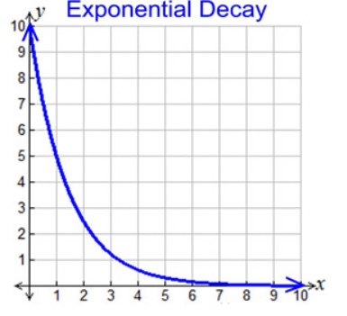
Convolution
Imagine it's new year's eve and there's just loads of fireworks going off and our goal is to figure out how much smoke is in the air
Smoke function S(t) :and that is the function that describes when I set off a single firework how much smoke is in the air because of that one firework and we might imagine that it looks like some sort of exponential decay so initially we have the max amount of smoke in the air but as time progresses and the smoke dissipates well the smoke in the air decreases

Slide 4
The next function we're going to be looking at is called the fireworks function f(t) and that basically just says how many fireworks are we setting off each minute
so if we're trying to figure out how much smoke is at the end of a certain time frame after say five minutes well it should make sense that we have to somehow cumulatively add up the amount of fireworks that we're setting off each minute combined with each fireworks smoke function to figure out how much smoke is in the air at the end of five minutes
How do we do this mathematically?

Slide 5
example
well let's start by looking at this minute by minute
so at minute zero let's just say that we are setting off one firework so that means f of zero is equal to one f(0) =1 so just one firework at minute zero
so how much smoke is in the air at minute zero
well it should make sense that we just multiply f of zero which is one times the smoke function of zero that gives us the amount of smoke at the start of minute zero f(0).S(0)= 1.S(0)
All right so what about minute one then, let's just say that f of one is equal to two so at minute one we're setting off not one but two fireworks

Slide 6
examples
So at minute one we have two fireworks
Now the amount of smoke at minute one should just be f of zero the previous minutes fireworks times s of one because those previous fireworks have had one minute to dissipate plus the newly created smoke f of one times s of zero
f(0).S(1) +f(1).S(0) = 1.S(0)+2.S(0)

Slide 7
example
All right so now let's go on to minute two
How much smoke is there at minute two
well if you can notice the pattern, it should be just f of zero times s of two plus f of one times s of one plus f of two the newly created smoke at minute two times s of zero
We can of-course extend this to any arbitrary time frame

Slide 8
example
So let's look at minute five for example at minute five we have f of zero times s of five that's how much smoke is left over from the first round of fireworks plus f of one times s of four plus f of two times s of three plus f of three times s of two plus f of four times s of one and finally plus the newly created smoke at minute five which is f of five times s of zero
This should make intuitive sense that the amount of smoke left over at the end of any arbitrary time frame is just the sum of these contributions from the newly created fireworks at each minute so mathematically what we've done is we have convolved these two functions
we have convolved the fireworks function f and the smoke function S

Slide 9

example
To put this mathematically well it looks something like this:-
Here's another one:- when i'm talking to you right now you don't just hear the sounds that i'm making right now you're hearing a combination of those sounds as well as the previous sounds that i've made as they echo throughout the room and eventually make their way to you so in a sense you're hearing the convolution of two functions one function is a function that describes the sounds i'm making over time and another function is one that describes how those sounds echo throughout the room and eventually hit you.

